Slide 1
SharedSource ECNY
A Place to go to Save Time and Money

Slide 2
Welcome and Introductions
Please share:
Name
Role in the Field
Familiarity with the SharedSource ECNY Platform or Shared Services

Slide 3
Session Goal
Upon completion of this session participants will utilize the SharedSource ECNY Platform to help them with time and money savings.

Slide 4
Session Objectives
Identify the location of 3 different resources on the SharedSource ECNY for program development.
Articulate 3 different cost savings programs on the platform that can save money in their current budget.
Locate 3 different templates to assist in meeting regulations.

Slide 5
Agenda
Welcome and Introductions
Purpose of Shared Services
Activity: Challenges/Wishes
Tour of SharedSource ECNY
How to gain access to SharedSource ECNY

Slide 6
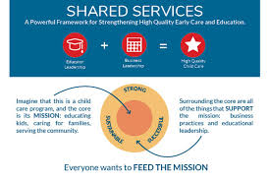
The Purpose of SharedSource ECNY
An online platform that delivers a wealth of practical resources for early childhood education directors, family care providers, and teachers. Its goal is clear: to help save time, reduce costs, and improve quality. Most simply, the platform helps its users manage their programs more efficiently.

Slide 7
Challenges that Waste Time and Money
Small Group Activity
Chart Challenges in your daily work routine that:
Waste Time
Waste Money

Slide 8
In my day I wish I had more….
In Small Groups, document the areas in your job you wish you could spend more time and energy.

Slide 9
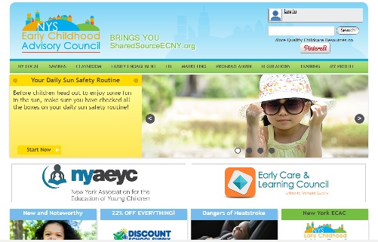
SharedSource ECNY Tour

Slide 10
Access to SharedSource ECNY
New York Association for the Education of Young Children Member Benefit.
Access comes with any level of membership

Slide 11
NYAEYC Membership Options
Premium Membership
This membership category provides unparalleled access for professionals who are committed to staying up-to-date with professional resources and best practices in early childhood education. ~$150.00
Standard Membership
NAEYC’s most popular membership. Standard membership ensures that you’re fully equipped for success as a professional. ~$69.00
Entry Level Membership
This digitally-based introduction gives you access to the latest content, resources, peer networking, and more at an unbeatable price! ~$30.00

Slide 12
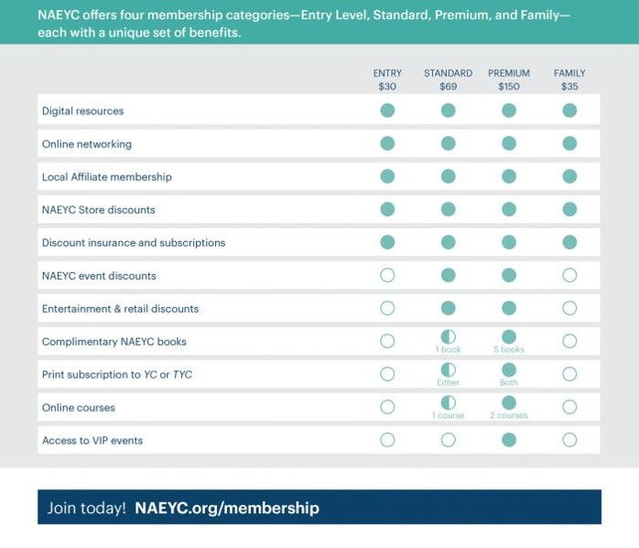
Benefits Beyond SharedSource ECNY
NAEYC Member Benefits
New York State Member Benefits
Mini Grants for your school
Conference Scholarships
Free state conference registration if presenting a workshop
State newsletter two times per year and E-Newsletters at least twice a year
Leadership opportunities on the local, state and national level to serve on boards, advisory councils, statewide committees, and chapter committees

Slide 13
Questions

Slide 14
Thank You!
NYAEYC Contact Information:
Avril Mills, Professional Development Coordinator amills@nyaeyc.org
Facilitator Contact Information:
Name
Email
Phone

